Slide 1
CPS 315 OOP Collaborative Programming Project 13.8
By: Doua Yang, Chris Carmody and Sam Harris
Date: 08/08/2018

Slide 2
Project one: Programming Exercise 13.8
Design and implement a program that prompts the user to enter a string and then performs two palindrome tests. The first should use a single stack to test whether the string is a palindrome. The second should use two stacks to test whether the string is a palindrome when capitalization, spaces, punctuation, and other non-alphanumeric characters are ignored. The program should print the results of both tests.

Slide 3
Collaborative Tools
Slack collaborative work space
GitHub code sharing platform

Slide 4
Slack
Slack is a collaborative platform that allows for team members to communicate with and update the entire team on the status of work and projects seamlessly.
Slack pushes notifications to team members when updates are entered and allows for tracking of updates on GitHub.

Slide 5
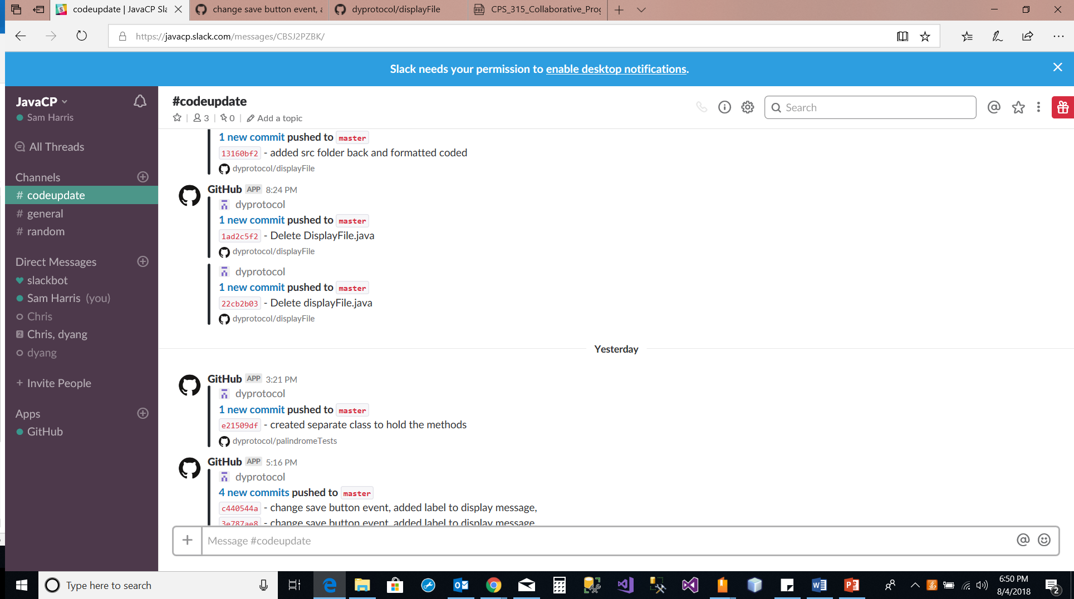
Slack in use showing notifications of code updates

Slide 6
GitHub
GitHub is a web-based hosting service bosting open source versioning control of software projects.

Slide 7
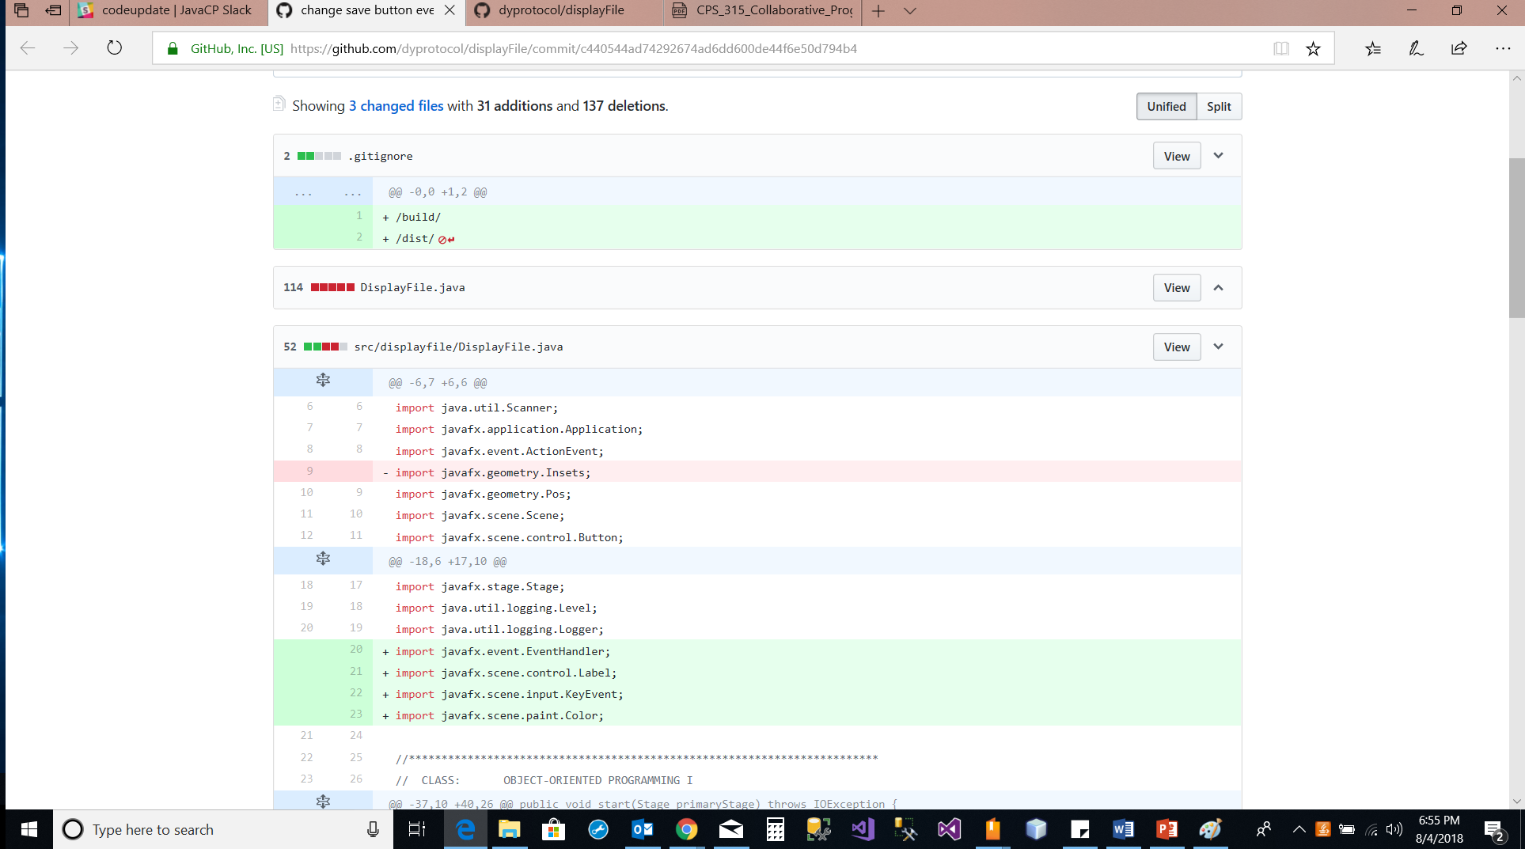
Github in use showing revisioning tools in place.

Slide 8
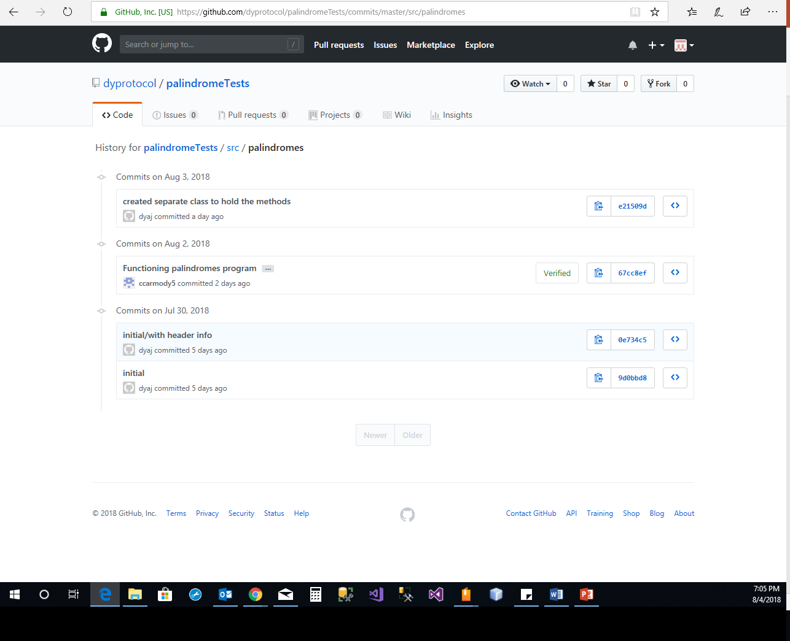
Github in use showing Testing and time stamp tools.

Slide 9
Group activities
Doua took the lead and setup both the slack account and GitHub account for the group to get started with communication and code sharing.
Chris took the lead on the program design for project 13.8 and was able to quickly get working code out to the group for testing and verification.

Slide 10
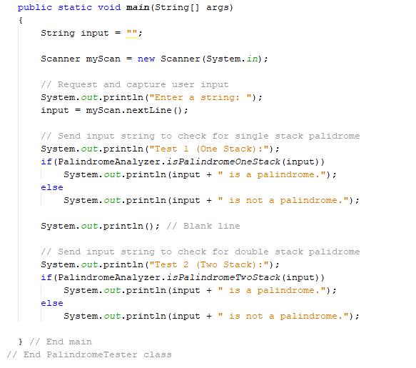
Code

Slide 11
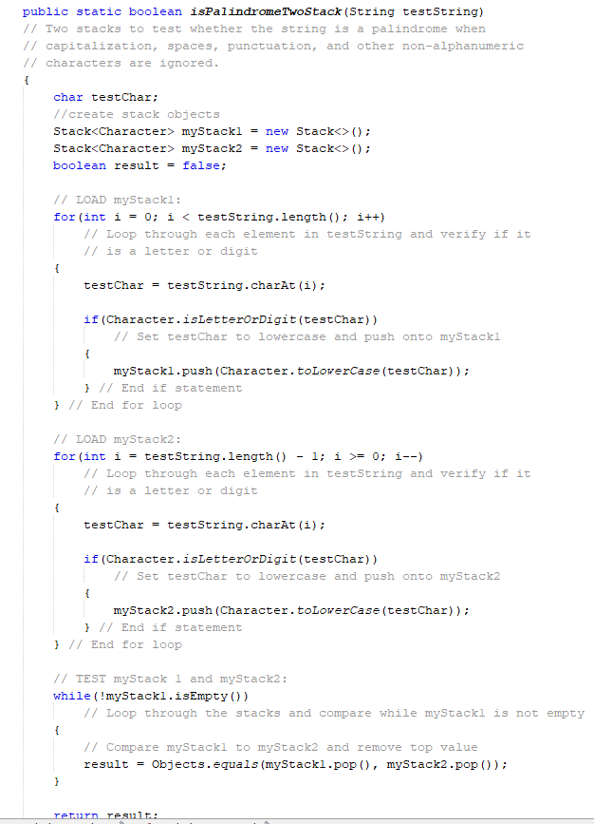
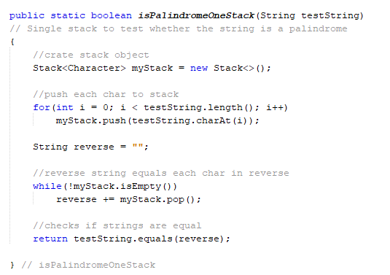
Code

Slide 12
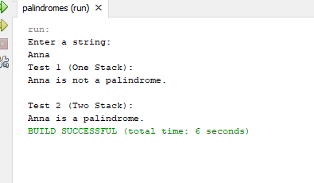
Application

